Slide 1

Megaminx
MMR 2020 – Group 3

Slide 2
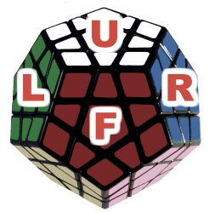
Allowed Moves
Up
Right
Front
Left

Slide 3
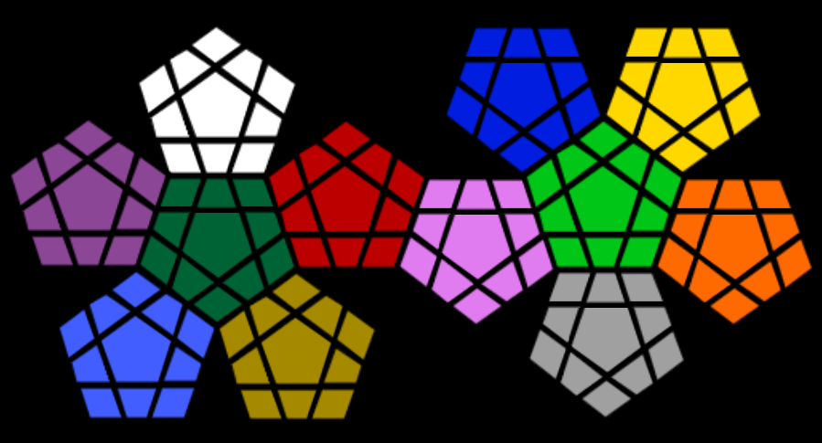
Numeration Method
1) Core
2) Down
3) Clockwise
G5
G6
G7
G4
G8
G0
G3
G9
G2
G10
G1

Slide 4


Numeration Method
G: Green
W: White
Pr: Purple
T: Turquoise
H: Honey
R: Red
L: Lime Green
Gr: Grey
O: Orange
Y: Yellow
B: Blue
Pi: Pink
W6
B5
B6
B7
Y5
Y6
Y7
W5
W7
B4
B8
Y4
Y8
W4
W8
B0
Y0
W0
B3
B9
Y3
Y9
Pr6
W3
W9
B2
B10
Y2
Y10
R6
L6
Y1
Pr5
Pr7
W2
W1
W10
R5
R7
B1
L5
L7
Pr4
Pr8
G5
R4
R8
L4
L8
O5
Pr0
G6
G7
R0
Pi5
Pi6
Pi7
L0
O6
O7
Pr3
Pr9
G4
G8
R3
R9
P4
Pi8
L3
L9
O4
O8
Pr2
Pr1
Pr10
G0
R2
R1
R10
Pi0
L2
L1
L10
O0
G3
G9
Pi3
Pi9
O3
O9
T6
G2
G10
H6
Pi2
Pi10
Gr5
Gr6
Gr7
O2
O10
T5
T7
G1
H5
Pi1
O1
T4
H7
Gr4
Gr0
Gr8
T8
H4
H8
T0
H0
Gr3
Gr9
T3
T9
H3
H9
Gr2
Gr10
T2
T1
T10
H2
H1
H10
Gr1

Slide 5
Basic Moves
Note: “negative” Move = 4x Normal Move
ACHTUNG: Es gibt 12 Moves
Moves\Environment | Online Megaminx Simulator | Our Prolog Code
White - clockwise | 2 | u+ -> w+
White - anticlockwise | 2‘ | u-
Blue - clockwise | 11 | r+
Blue - anticlockwise | 11‘ | r-
Red - clockwise | 6 | f+
Red - anticlockwise | 6‘ | f-
Green - clockwise | 1 (one) | l+ (L small-letter)
Green - anticlockwise | 1‘ | l-

Slide 6
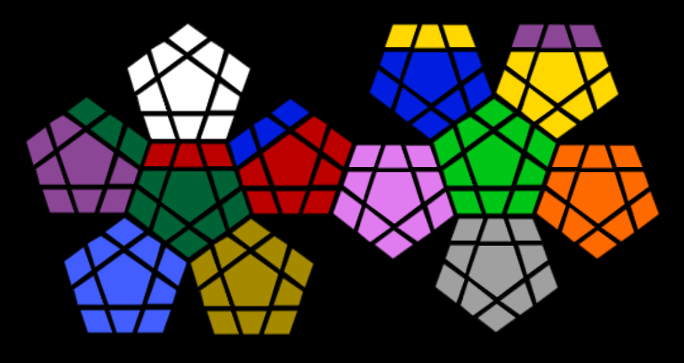
Basic MOVES
Prolog: u+
Online Simulator: 2
W6
Y5
Y6
Y7
Pr6
Pr7
Pr8
W5
W7
B4
B8
Y4
Y8
W4
W8
B0
Y0
W0
B3
B9
Y3
Y9
W3
W9
B2
B10
Y2
Y10
G5
B7
L6
Y1
Pr5
G6
W2
W1
W10
B6
R7
B1
L5
L7
Pr4
G7
R4
R5
R6
B5
R8
L4
L8
O5
Pr0
R0
Pi5
Pi6
Pi7
L0
O6
O7
Pr3
Pr9
G4
G8
R3
R9
P4
Pi8
L3
L9
O4
O8
Pr2
Pr1
Pr10
G0
R2
R1
R10
Pi0
L2
L1
L10
O0
G3
G9
Pi3
Pi9
O3
O9
T6
G2
G10
H6
Pi2
Pi10
Gr5
Gr6
Gr7
O2
O10
T5
T7
G1
H5
Pi1
O1
T4
H7
Gr4
Gr0
Gr8
T8
H4
H8
T0
H0
Gr3
Gr9
T3
T9
H3
H9
Gr2
Gr10
T2
T1
T10
H2
H1
H10
Gr1

Slide 7
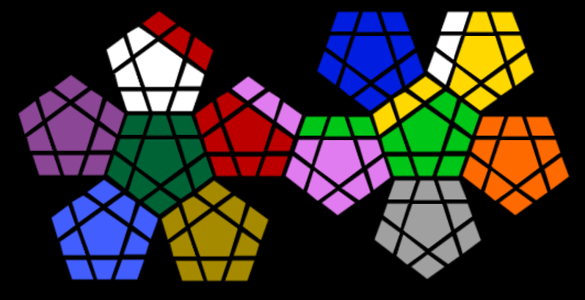
Basic MOVES
Prolog: r+
Online Simulator: 11
R6
B5
B6
B7
W8
Y6
Y7
W5
R7
B4
B8
W7
Y8
W4
R8
B0
Y0
W0
B3
B9
W6
Y9
Pr6
W3
W9
Pi5
B2
B10
Y2
Y10
Y5
Y1
Pr5
Pr7
W2
W1
W10
R5
Pi6
B1
Y4
L7
Pr4
Pr8
G5
R4
Pi7
L4
Y3
L8
O5
Pr0
G6
G7
R0
L5
L6
L0
O6
O7
Pr3
Pr9
G4
G8
R3
R9
P4
Pi8
L3
L9
O4
O8
Pr2
Pr1
Pr10
G0
R2
R1
R10
Pi0
L2
L1
L10
O0
G3
G9
Pi3
Pi9
O3
O9
T6
G2
G10
H6
Pi2
Pi10
Gr5
Gr6
Gr7
O2
O10
T5
T7
G1
H5
Pi1
O1
T4
H7
Gr4
Gr0
Gr8
T8
H4
H8
T0
H0
Gr3
Gr9
T3
T9
H3
H9
Gr2
Gr10
T2
T1
T10
H2
H1
H10
Gr1

Slide 8
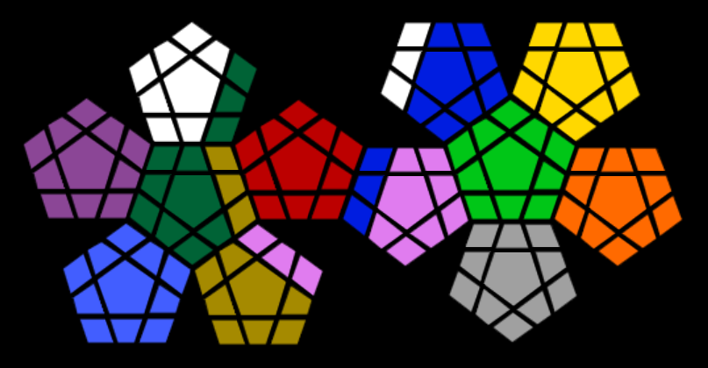
Basic MOVES
Prolog: f+
Online Simulator: 6
W6
W10
B6
B7
Y5
Y6
Y7
W5
W7
W9
B8
Y4
Y8
W4
G7
B0
Y0
W0
W8
B9
Y3
Y9
Pr6
W3
G8
B2
B10
Y2
Y10
R6
L6
Y1
Pr5
Pr7
W2
W1
G9
R5
R7
B1
L5
L7
Pr4
Pr8
G5
H6
R4
R8
L4
L8
O5
Pr0
G6
R0
B5
Pi6
Pi7
L0
O6
O7
Pr3
Pr9
G4
H7
R3
R9
B4
Pi8
L3
L9
O4
O8
Pr2
Pr1
Pr10
G0
R2
R1
R10
Pi0
L2
L1
L10
O0
G3
H8
B3
Pi9
O3
O9
T6
G2
G10
Pi3
Pi2
Pi10
Gr5
Gr6
Gr7
O2
O10
T5
T7
G1
H5
P4
Pi1
O1
T4
Pi5
Gr4
Gr0
Gr8
T8
H4
T0
H0
Gr3
Gr9
T3
T9
H3
H9
Gr2
Gr10
T2
T1
T10
H2
H1
H10
Gr1

Slide 9
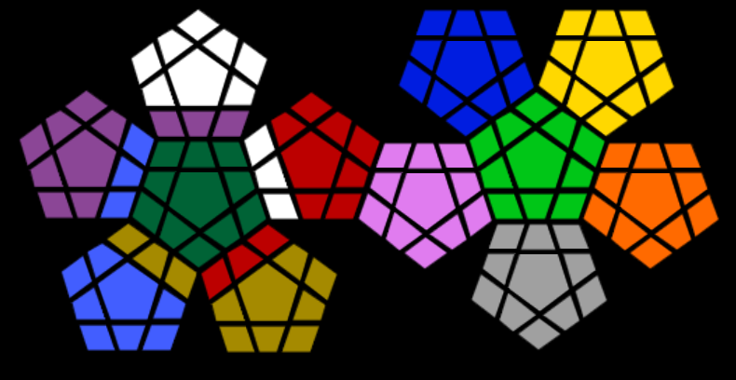
Basic MOVES
Prolog: l+ (L small-letter)
Online Simulator: 1 (one)
W6
B5
B6
B7
Y5
Y6
Y7
W5
W7
B4
B8
Y4
Y8
W4
W8
B0
Y0
W0
B3
B9
Y3
Y9
Pr6
W3
W9
B2
B10
Y2
Y10
R6
L6
Y1
Pr5
Pr7
Pr10
Pr9
Pr8
R5
R7
B1
L5
L7
Pr4
T6
G5
W2
R8
L4
L8
O5
Pr0
G6
G7
R0
Pi5
Pi6
Pi7
L0
O6
O7
Pr3
T7
G4
G8
W1
R9
P4
Pi8
L3
L9
O4
O8
Pr2
Pr1
T8
G0
R1
R10
Pi0
L2
L1
L10
O0
G3
G9
W10
Pi3
Pi9
O3
O9
H4
G2
G10
R4
Pi2
Pi10
Gr5
Gr6
Gr7
O2
O10
T5
H5
G1
R3
Pi1
O1
T4
R2
H7
Gr4
Gr0
Gr8
H6
H8
T0
H0
Gr3
Gr9
T3
T9
H3
H9
Gr2
Gr10
T2
T1
T10
H2
H1
H10
Gr1

Slide 10
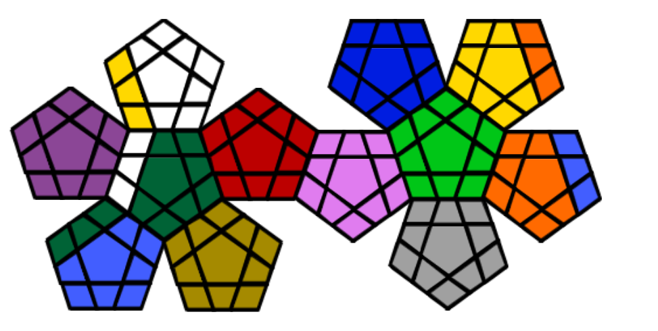
Basic MOVES
Prolog: pr
Online Simulator: 3
W6
B5
B6
B7
Y5
Y6
O7
W5
W7
B4
B8
Y4
O8
Y9
W8
B0
Y0
W0
B3
B9
Y3
O9
Pr6
Y8
W9
B2
B10
Y2
Y10
R6
L6
Y1
Pr5
Pr7
Y7
W1
W10
R5
R7
B1
L5
L7
Pr4
Pr8
W4
R4
R8
L4
L8
O5
Pr0
G6
G7
R0
Pi5
Pi6
Pi7
L0
O6
T4
Pr3
Pr9
W3
G8
R3
R9
P4
Pi8
L3
L9
O4
T5
Pr2
Pr1
Pr10
G0
R2
R1
R10
Pi0
L2
L1
L10
O0
W2
G9
Pi3
Pi9
O3
T6
G5
G2
G10
H6
Pi2
Pi10
Gr5
Gr6
Gr7
O2
O10
G4
T7
G1
H5
Pi1
O1
G3
H7
Gr4
Gr0
Gr8
T8
H4
H8
T0
H0
Gr3
Gr9
T3
T9
H3
H9
Gr2
Gr10
T2
T1
T10
H2
H1
H10
Gr1

Slide 11
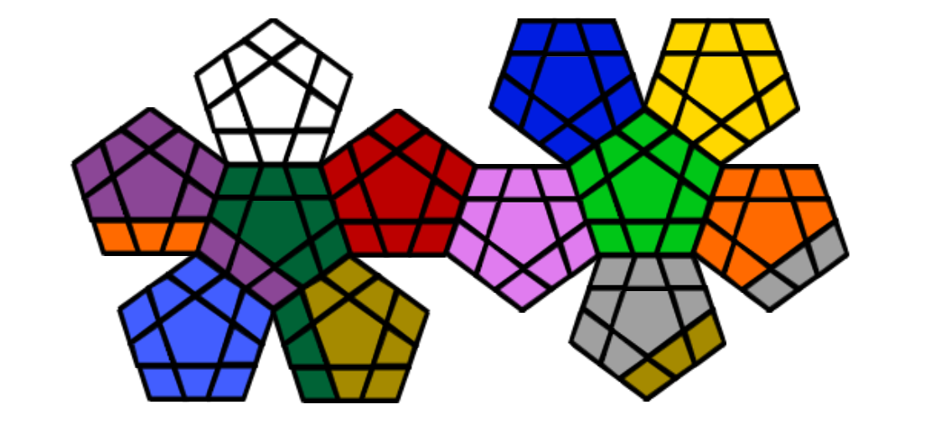
Basic MOVES
Prolog: t
Online Simulator: 4
W6
B5
B6
B7
Y5
Y6
Y7
W5
W7
B4
B8
Y4
Y8
W4
W8
B0
Y0
W0
B3
B9
Y3
Y9
Pr6
W3
W9
B2
B10
Y2
Y10
R6
L6
Y1
Pr5
Pr7
W2
W1
W10
R5
R7
B1
L5
L7
Pr4
Pr8
G5
R4
R8
L4
L8
O5
Pr0
G6
G7
R0
Pi5
Pi6
Pi7
L0
O6
O7
Pr3
Pr9
G4
G8
R3
R9
P4
Pi8
L3
L9
O4
O8
O10
O9
G0
R2
R1
R10
Pi0
L2
L1
L10
O0
O1
Pr2
G9
Pi3
Pi9
O3
Gr9
T6
Pr1
G10
H6
Pi2
Pi10
Gr5
Gr6
Gr7
O2
Gr10
T5
T7
Pr10
H5
H7
Pi1
Gr8
Gr1
T4
G3
Gr4
Gr0
T0
T8
H8
G2
H0
Gr3
H2
T3
T9
H9
Gr2
H3
T2
T1
T10
G1
H1
H10
H4

Slide 12
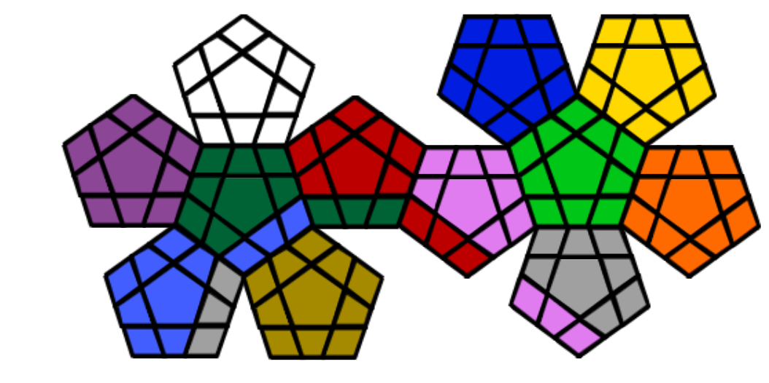
Basic MOVES
Prolog: h
Online Simulator: 5
W6
B5
B6
B7
Y5
Y6
Y7
W5
W7
B4
B8
Y4
Y8
W4
W8
B0
Y0
W0
B3
B9
Y3
Y9
Pr6
W3
W9
B2
B10
Y2
Y10
R6
L6
Y1
Pr5
Pr7
W2
W1
W10
R5
R7
B1
L5
L7
Pr4
Pr8
G5
R4
R8
L4
L8
O5
Pr0
G6
G7
R0
Pi5
Pi6
Pi7
L0
O6
O7
Pr3
Pr9
G4
G8
R3
R9
P4
Pi8
L3
L9
O4
O8
Pr2
Pr1
Pr10
G0
Pi0
L2
L1
L10
O0
G3
T8
G1
G10
G9
R2
Pi9
O3
O9
T6
G2
T9
H6
R1
Pi10
Gr5
Gr6
Gr7
O2
O10
T5
T7
T10
H5
R10
O1
T4
H7
Gr4
Gr0
Gr8
Gr1
H4
H8
T0
H0
Pi3
Gr9
T3
Gr2
H3
H9
Pi2
Gr10
T2
T1
Gr3
H2
H1
H10
Pi1

Slide 13
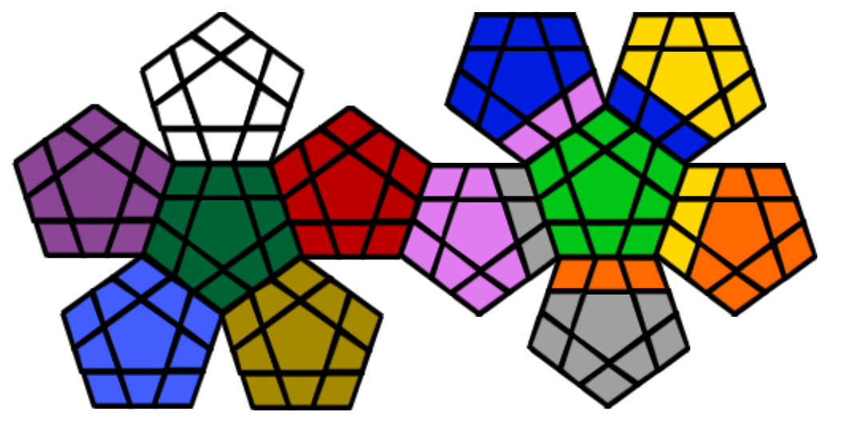
Basic MOVES
Prolog: l
Online Simulator: 7
W6
B5
B6
B7
Y5
Y6
Y7
W5
W7
B4
B8
Y4
Y8
W4
W8
B0
Y0
W0
B3
Pi7
B1
Y9
Pr6
W3
W9
B2
Pi8
B10
Y10
R6
Pi9
L6
B9
Pr5
Pr7
W2
W1
W10
R5
R7
L5
L7
Pr4
Pr8
G5
R4
R8
L4
L8
Pr0
G6
G7
R0
Pi5
Pi6
Gr5
L0
Y3
O6
O7
Pr3
Pr9
G4
G8
R3
R9
P4
Gr6
L3
L9
Y2
O8
Pr2
Pr1
Pr10
G0
R2
R1
R10
Pi0
L2
L1
L10
O0
G3
G9
Pi3
Gr7
Y1
O9
T6
G2
G10
H6
Pi2
Pi10
O3
O4
O5
O2
O10
T5
T7
G1
H5
Pi1
O1
T4
H7
Gr4
Gr0
Gr8
T8
H4
H8
T0
H0
Gr3
Gr9
T3
T9
H3
H9
Gr2
Gr10
T2
T1
T10
H2
H1
H10
Gr1

Slide 14
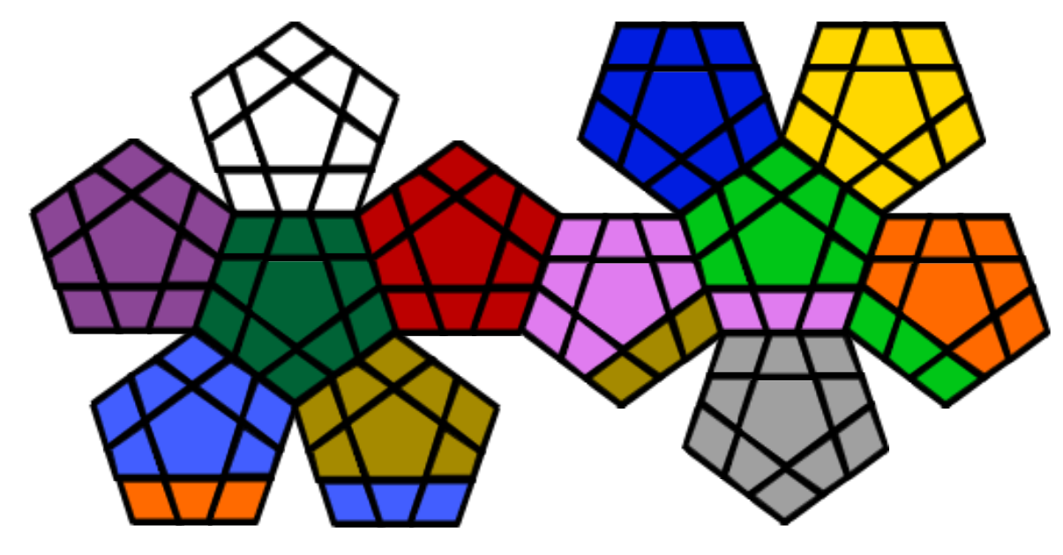
Basic MOVES
Prolog: gr
Online Simulator: 8
W6
B5
B6
B7
Y5
Y6
Y7
W5
W7
B4
B8
Y4
Y8
W4
W8
B0
Y0
W0
B3
B9
Y3
Y9
Pr6
W3
W9
B2
B10
Y2
Y10
R6
L6
Y1
Pr5
Pr7
W2
W1
W10
R5
R7
B1
L5
L7
Pr4
Pr8
G5
R4
R8
L4
L8
O5
Pr0
G6
G7
R0
Pi5
Pi6
Pi7
L0
O6
O7
Pr3
Pr9
G4
G8
R3
R9
P4
Pi8
L3
L9
O4
O8
Pr2
Pr1
Pr10
G0
R2
R1
R10
Pi0
Pi1
Pi10
Pi9
O0
G3
G9
Pi3
H10
L2
O9
T6
G2
G10
H6
Pi2
H1
Gr5
Gr6
Gr7
L1
O10
T5
T7
G1
H5
H2
L10
T4
H7
Gr4
Gr0
Gr8
T8
H4
H8
T0
H0
Gr3
Gr9
T3
T9
H3
H9
Gr2
Gr10
O3
O2
O1
T2
T1
T10
Gr1

Slide 15
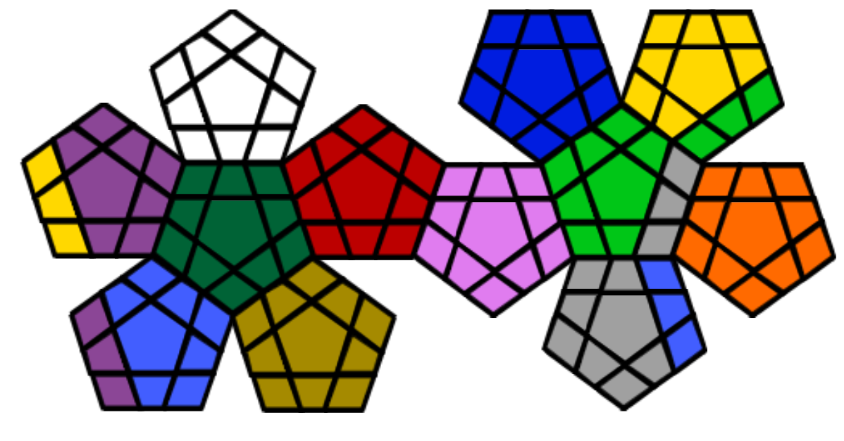
Basic MOVES
Prolog: o
Online Simulator: 9
W6
B5
B6
B7
Y5
Y6
Y7
W5
W7
B4
B8
Y4
Y8
W4
W8
B0
Y0
W0
B3
B9
Y3
L8
Pr6
W3
W9
B2
B10
Y2
L9
R6
L6
L10
Pr5
Pr7
W2
W1
W10
R5
R7
B1
L5
L7
Y1
Pr8
G5
G6
G7
R4
R8
Pi5
L4
Gr7
O5
O6
O7
Pr0
R0
Pi6
Pi7
L0
Y10
Pr9
G4
G8
R3
R9
P4
Pi8
L3
Gr8
O4
O8
Y9
Pr1
Pr10
G0
R2
R1
R10
Pi0
L2
L1
Gr9
O0
G3
G9
Pi3
Pi9
O3
O9
T6
G2
G10
H6
Pi2
Pi10
Gr5
Gr6
T2
O2
O10
T5
T7
G1
H5
Pi1
O1
H7
Gr4
Gr0
T3
Pr4
T8
H4
H8
T0
H0
Gr3
T4
Pr3
T9
H3
H9
Gr2
Gr10
Pr2
T1
T10
H2
H1
H10
Gr1

Slide 16
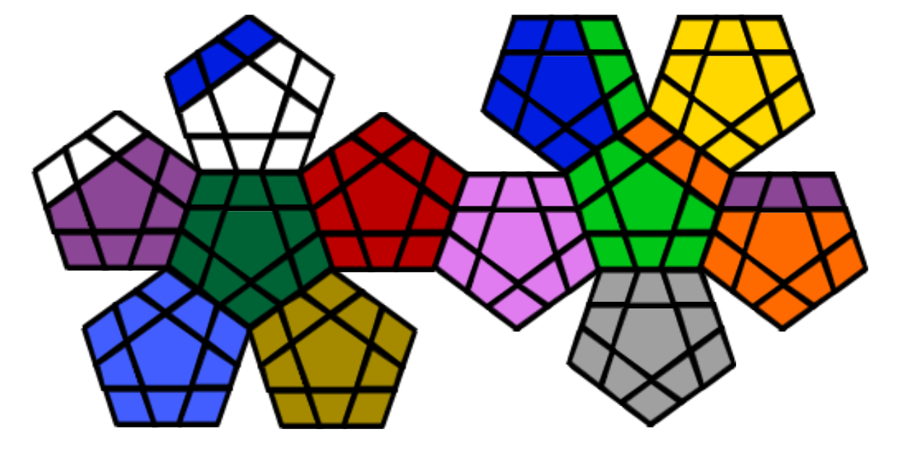
Basic MOVES
Prolog: y
Online Simulator: 10
B9
B5
B6
L6
Y5
Y6
Y7
B8
W7
B4
L7
Y4
Y8
B7
W8
B0
Y0
W0
B3
L8
Y3
Y9
W3
W9
B2
B10
Y2
Y10
W6
R6
O5
Y1
W5
Pr7
W2
W1
W10
R5
R7
B1
L5
O6
W4
Pr8
G5
G6
G7
R4
R8
Pi5
L4
O7
Pr4
Pr5
Pr6
Pr0
R0
Pi6
Pi7
L0
Pr3
Pr9
G4
G8
R3
R9
P4
Pi8
L3
L9
O4
O8
Pr2
Pr1
Pr10
G0
R2
R1
R10
Pi0
L2
L1
L10
O0
G3
G9
Pi3
Pi9
O3
O9
T6
G2
G10
H6
Pi2
Pi10
Gr5
Gr6
Gr7
O2
O10
T5
T7
G1
H5
Pi1
O1
T4
H7
Gr4
Gr0
Gr8
T8
H4
H8
T0
H0
Gr3
Gr9
T3
T9
H3
H9
Gr2
Gr10
T2
T1
T10
H2
H1
H10
Gr1

Slide 17
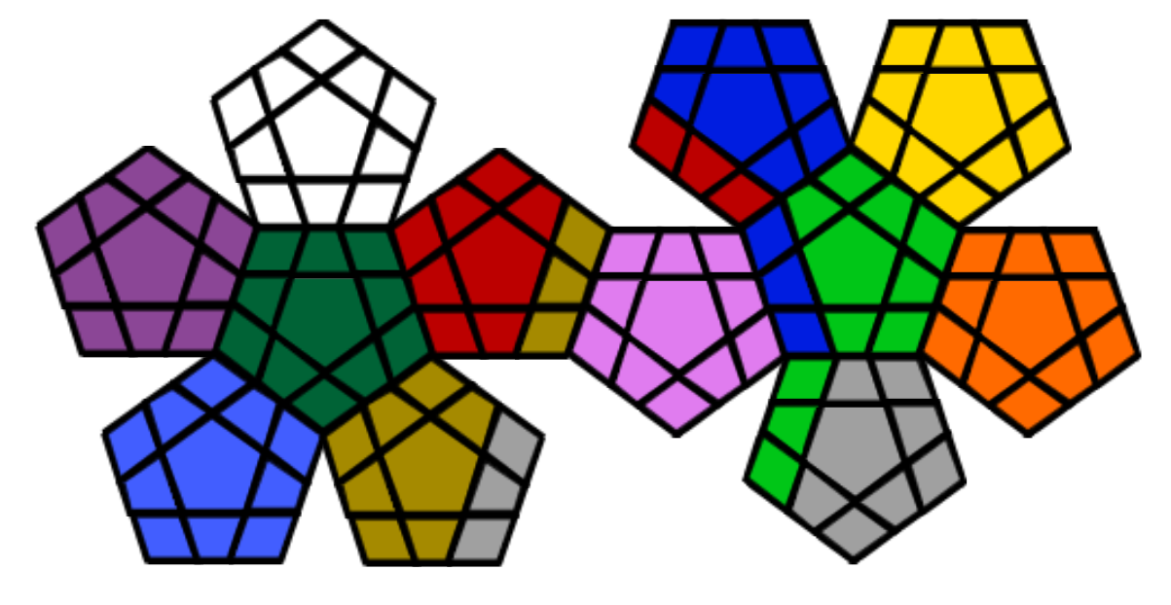
Basic MOVES
Prolog: pi
Online Simulator: 12
W6
B5
B6
B7
Y5
Y6
Y7
W5
W7
B4
B8
Y4
Y8
W4
W8
B0
Y0
W0
R10
B9
Y3
Y9
Pr6
W3
W9
R9
B10
Y2
Y10
R6
L6
Y1
Pr5
Pr7
W2
W1
W10
R5
R7
R8
L5
L7
Pr4
Pr8
G5
R4
H8
B3
L8
O5
Pr0
G6
G7
R0
Pi5
Pi6
Pi7
L0
O6
O7
Pr3
Pr9
G4
G8
R3
H9
P4
Pi8
B2
L9
O4
O8
Pr2
Pr1
Pr10
G0
R2
R1
H10
Pi0
L1
L10
O0
G3
G9
Pi3
B1
O3
O9
Pi9
T6
G2
G10
H6
Pi2
Pi10
L4
Gr6
Gr7
O2
O10
T5
T7
G1
H5
Pi1
O1
T4
H7
Gr3
L3
Gr0
Gr8
T8
H4
T0
H0
L2
Gr9
T3
T9
H3
Gr4
Gr2
Gr10
T2
T1
T10
H2
H1
Gr5
Gr1

